Slide 1
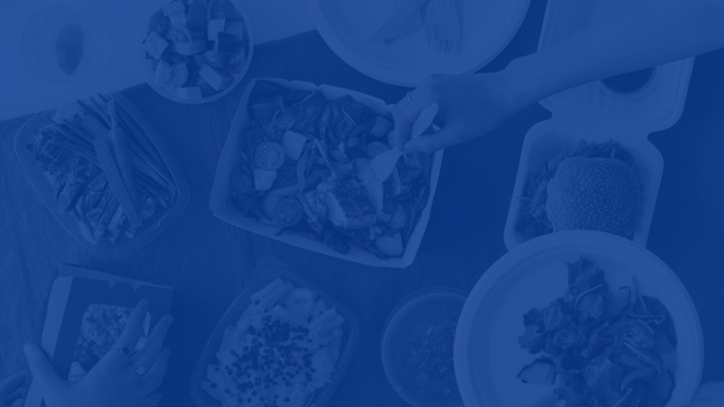

STILL TASTY
REDUCE WASTE SAVE TASTE
2024
INOVM0015: INNOVATION, ENTREPRENEURSHIP AND ENTERPRISE
BUSINESS PLAN
10/12/2023 CONFIDENTIAL
DURATION: 12:00
Team 17 - Will Morris - Seth Hutchins - Anthony Roberts - Reuben Marland

Slide 2

The Issue
199,100 tons of food wasted annually by UK restaurants [1]
199,100 tons of food wasted annually by UK restaurants [1]
This is equivalent to 320 million meals
This is equivalent to 320 million meals
Costs restaurants £682 million per year [1]
Costs restaurants £682 million per year [1]
On average, over 8 meals are thrown in the bin by restaurants per week
On average, over 8 meals are thrown in the bin by restaurants per week
Notes:
Every year in the uk 199,100 tonnes of food is wasted in restaurants, at a cost of £682 million. From our research we found that on average restaurants throw away at least one meal per day, with some throwing away up to 10. The reason these meals aren’t eaten isn’t due to quality issues, but because the customer sat in the restaurant has an allergy, or there were other issues with tickets. This provides an opportunity to connect restaurant quality food with other potential customers for a cheap price.
Currently, these meals are needlessly wasted, and most often end up thrown away, as there isn’t a customer present to eat it.

Slide 3




The Idea
Fresh Food
Fresh Food
Discounted Meals
Discounted Meals
Hungry Customers ++
Hungry Customers ++
Budget Foodies ++
Budget Foodies ++
Notes:
The principle behind our app, Still Tasty, is for restaurants to easily sell these potentially wasted meals. Our app will list these meals, at a reduced price, for each restaurant and notify potential customers when they become available, we then split the profit from each meal with the restaurant providing a mutually beneficial solution.

Slide 4


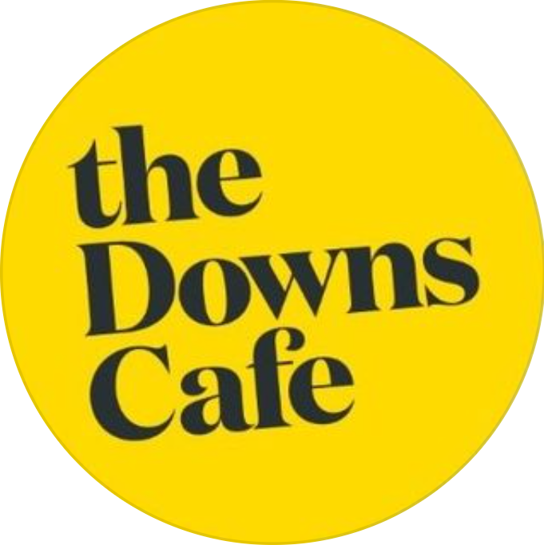
Expert Accounts
“We throw away 5 pizzas daily, and there’s even more wastage… deserts and starters”
“TooGoodToGo makes it harder for us to consider stock… often we’ll cancel”
-Manager
“We throw away 5 pizzas daily, and there’s even more wastage… deserts and starters”
“TooGoodToGo makes it harder for us to consider stock… often we’ll cancel”
-Manager
“The Met misfires a couple of meals a day”
“A couple of kg of food waste a day”
“Selling fresh and hot food that would otherwise go in the trash would be ideal”
- Director
“The Met misfires a couple of meals a day”
“A couple of kg of food waste a day”
“Selling fresh and hot food that would otherwise go in the trash would be ideal”
- Director
“In summer 3-4 times a day people do not come and collect food”
“TooGoodToGo only sells items that are at least 3 days old”
-Owner
“In summer 3-4 times a day people do not come and collect food”
“TooGoodToGo only sells items that are at least 3 days old”
-Owner
Notes:
After speaking to several businesses about their individual food waste, we found that restaurants are looking for opportunities to limit their waste and widen their customer base, and currently there is no service to help them achieve these goals.

Slide 5

Affiliate Logistics
List the meal on the Still Tasty affiliate app
List the meal on the Still Tasty affiliate app
Box the meal and keep warm for customer for 30 minutes
Box the meal and keep warm for customer for 30 minutes
After 30 minutes move the meal to the fridge
Restaurant makes a meal incorrectly
After 30 minutes move the meal to the fridge
Restaurant makes a meal incorrectly
Notes:
As a restaurant, you sign up to our free service, which allows you to list meals through our app. the next time a meal is made in error for example a customer has an allergy, the restaurant lists the meal on our app, and packs it ready for collection.
Our app also provides exposure opportunities for smaller restaurants as it means people can try their meals at a lower price point. Restaurants are also given further exposure through customers using the wishlist feature which advertises other restaurants to a wider range of customers. This will help spread awareness of these smaller businesses.
This system also provides opportunities for smaller restaurants as if the food goes unreserved, the app will notify a wider range of potential customers with similar tastes about the available food. This will help spread awareness of these smaller businesses.

Slide 6

Customer Logistics
Priority given to first customer to confirm the purchase
Priority given to first customer to confirm the purchase
Customer can collect the meal within 15 minutes
Customer can collect the meal within 15 minutes
Meal held for up to 2 hours
Wishlisted customers receive push notification that a meal is available
Meal held for up to 2 hours
Wishlisted customers receive push notification that a meal is available
Notes:
A customer will download the app and create a “Wishlist” of the restaurants and types of food they are interested in. Customers create their personal wishlist by browsing the vast selection of restaurants that we have partnered with. When a wish listed meal is listed by a restaurant the app will notify the interested customers in the area that a meal is available. The first customer to reserve it can then pay for the meal and collect their order immediately after purchasing.

Slide 7

System Diagram
Less food is wasted
Less food is wasted
Restaurant error
Less food is wasted
Restaurant error
Restaurant updates app
Restaurant updates app
Food gets put in the fridge after 30 mins for later customers
Food gets put in the fridge after 30 mins for later customers
App notifies customer of available food
App notifies customer of available food
Customer picks up food within 30 minutes
Customer picks up food within 30 minutes
Notes:
The simplicity of use of the app, for both customer and restaurant is evident in the system diagram that shows the general process followed when using Still Tasty.

Slide 8




Pricing Strategy
Percentage price breakdown [2]
Average price breakdown
100% meal price
£12 average meal price
42% discount
£5 discount
Merchant Commission
£4 to the restaurant
25% Still Tasty Revenue
£3 to Still Tasty
58% of full price
£7 cost to customer
Notes:
Our pricing strategy was created to minimise the cost to the customer, whilst maximising revenue for the restaurant and Still tasty. The split of profit between us and the restaurant is slightly favoured to the restaurant, in order to make partnering with us more appealing. The restaurants commission was weighted in order for them to make back, at minimum, the cost to produce the meal, based upon industry standards, as the alternative would simply be to throw away the food.

Slide 9



Competitor Analysis
Competitors | Price | Fulfilment Time | Sustainability | Restaurant Ease | Consumer Ease | Quality
Deliveroo
Fast Food
TooGoodToGo
Still Tasty
Notes:
Still Tasty’s main competitor in the takeaway food space is toogoodtoogo. From our market research, we identified a number of issues with the service that they provide for both the customer and the restaurants it serves.
From the restaurants perspective, the main issue highlighted to us was the difficulty of managing pre-listings of food that may not remain available or may be more abundant than anticipated. We have solved this issue, as food on Still Tasty is listed as and when it becomes available and is always fresh.
Furthermore, from surveys of the potential customer base, the main issues highlighted were having to reserve food well in advance, and the unpredictability of what you get from TooGoodToGo orders. Both of these issues are solved by Still Tasty. The food is always ready as and when you reserve it so there’s no long wait time, and you’re always guaranteed to get what you reserve.

Slide 10
Value Proposition
Affiliates
Customers
Time
Gains
Cheap
Time
Cheap
Waste Disposal
Lost Revenue
Waste Disposal
Lost Revenue
Sustainability
Sustainability
Diet Variation
Diet Variation
Improving Environmental Impact
Cost of traditional takeaway
Improving Environmental Impact
Cost of traditional takeaway
Pains
Advertising and Goodwill
Maximising Profit
Advertising and Goodwill
Maximising Profit
Restaurant quality
Restaurant quality
Notes:
Still Tasty’s value proposition included two customer segments, affiliate restaurants, and customers. Through surveys and interviews, we identified a number of gains, things that attract customers to us, and pains, problems that inconvenience customers that we can solve. The main gains to both vendors and consumers where monetary, with vendors earning an additional source of revenue, while consumers gain high quality meals at highly discounted prices. Additionally, there is a mutual feel-good factor gain, due to helping the environment.

Slide 11
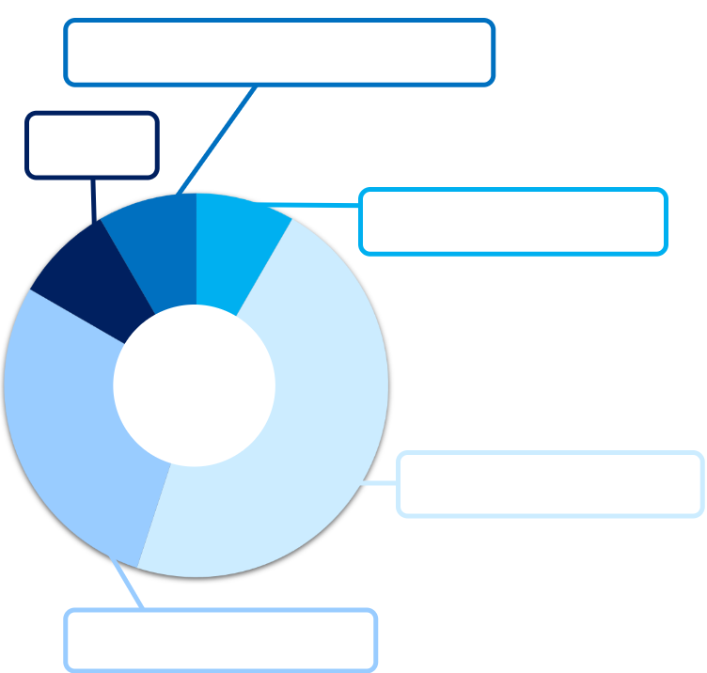
Survey Data
8% More Than Once or Twice a Week
8%, Never
Would You Use Still Tasty?
9%, Once or Twice a Week
“Would fit with my flexible schedule"
"Would save me a lot of money"
47%, Once or Twice a Year
"Sounds simple, affordable, fresh and convenient"
28%, Once or Twice a Month
60 Responses
Notes:
We surveyed 60 potential customers, of which, only 8% would not use Still Tasty, and 17% of respondents said they’d use the app weekly. Of the same surveyed group, only 45% of respondents said they use Too good To go, our main competitor.
As part of our market research, we also surveyed 18 restaurants in Bristol, of these restaurants, 8 expressed interest in joining still tasty as an affiliate. Furthermore, of these same 18, 13 said that logistically they would be able to use our app in the kitchen.
Of course, this data may not be fully indicative of the apps uptake upon launch, however, it provides a good indication that Still Tasty provides an appealing service to customers and clients.

Slide 12
Addressable Market
Bristol Market
UK Market
TAM
£8.8 million
£682 million [1]
SAM
£1.3 million
£205 million
SOM
£330
thousand
£51 million
Notes:
During the first phase of our business model, where we roll out in Bristol, our addressable market is as follows. The total available market in Bristol, or the value of all restaurant food waste in the city, is 8.8 million pounds. We estimated that 70% of this waste is from preparation or unusable, leaving a serviceable attainable market value of 1.3 million. We project that 25% of this would be up to standard to be sold on Still tasty, valued at 330 thousand pounds.
In the long term as a nationwide rollout, following the same projections, the Total Aaddressable Market is 682 million pounds, Serviceable available market is 205 million pounds, and the Serviceable obtainable market is 51 million pounds.

Slide 13
Market Analysis
Affiliate market
Customer market
Target market (50k) [4]
Target market (50k) [4]
1600 restaurants in Bristol [3]
1600 restaurants in Bristol [3]
1st year 10% download
1st year 10% download
1st year 3% of restaurants
1st year 3% of restaurants
1st year 20% use
1st year 20% use
Each use once per fortnight
Each use once per fortnight
48 restaurants
48 restaurants
Demand of 500 meals per week
Demand of 500 meals per week
384 meals per week
384 meals per week
Excess demand of 116 meals per week
Excess demand of 116 meals per week
Notes:
As we have two customers the market analysis can be split into affiliates and customers. There are 1600 restaurants in Bristol, we believe that in our first year we can attract 3% of these to use Still Tasty, this would be 48 restaurants. Our survey data reflected that more restaurants would use the service however we are aware that there is always an issue between expectation and reality and so it is better to use a far more conservative value to ensure accurate market data.
According to our survey data, each restaurant makes, on average, 8 meals in error per week. This gives a total market supply of 384 meals per week.
The target market is around 50 thousand people, this is made up of 36 thousand students and 14 thousand people in lower income brackets. In our first year we believe that with effective marketing 10% of this target market will download our app and of those 20% will buy meals through the app. A conservative estimate is that each person will use our app once per fortnight leading to an excess demand of 116 meals per week.

Slide 14




Route to Market
Public Advertising
Public Advertising
Launch
Restaurant Recruitment
Launch
App Development
Restaurant Recruitment
App Development
Full-front end and back-end development.
Curated by team and outside consultancy
In person meetings with restaurants
Building strong partnerships
Traditional advertising methods: billboards, magazines, etc.
Social media and partnerships
Initial app launch
Continued development to maintain competitive advantage
Notes:
There are four stages for our route to market. Stage 1 involves User interface design for the app and preliminary marketing to restaurants to ensure that affiliates are aware of us. Full front and back-end app development will be completed throughout the course of all stages to allow us to adapt to the needs of our customers and affiliates. This app development will be completed by our team in conjunction with an outside consultant. Stage 2 involves securing affiliates to partner with Still Tasty. This will be carried out through at in person meetings with local restaurant owners and directors to build strong relationships. Stage 3 involves gaining customers through advertising to the public. To ensure we reach a broad range of customers we will make use of traditional advertising methods such as billboards and magazines, alongside social media. Stage 4 involves the initial launch of the app and further development of our idea to ensure that we maintain our competitive advantage.

Slide 15


Business Insight
The most annoying part is when the chef has to stop and think about the meal they’ve cooked, where it's supposed to go now and what to do with it, this provides a great solution to that problem.
Breaking even [for our restaurant] is removing tax and dividing by 3, would be happy to do this.
I think the business [Still Tasty] would suit the restaurants a lot better than current options for food waste.
Anything working to limit those costs, any restaurant owner would be interested in.
Notes:
Some quotes from business owners are listed here. Whilst these are promising accounts, it is important to understand the possible disparity between the expected partnerships and those that are actualised when the product launches.

Slide 16
Partnerships
Absolutely, The Metropolitan would be really interested in partnering with
Still Tasty, we think it’s a great concept. We would like to get to work with the
opening. It would be an absolute win on both sides.
The Downs Café would be a really good match for Still Tasty we do get a lot of people running away and not collecting their orders and we’d love to be able to get those costs, feed as many people as possible, we think you would be a really good brand that we could work with.
Notes:
In discussions, 14 of the 18 restaurants surveyed said they would be open to joining Still Tasty upon launch. These restaurants included local establishments such as The Met and The Downs Café, alongside larger businesses such as Pizza Express. We are aware that to partner with larger entities such as Pizza Express we would require further talks with company executives; however the response from individual branch managers and employees was very positive.

Slide 17
Profit vs Cost
Notes:
The graph on the left shows the projected running balance of the business for the initial 3-year launch in Bristol. the average projection is modelled as if each restaurant lists 8 meals per week, the mean number of wasted meals of the 18 restaurants surveyed. The minimum and maximum projections are found using the mean number of wasted meals, plus or minus one standard deviation of the data. The lowest occurring minimum balance in the worst case scenario is -£50 000 and we project that we will break even around halfway through year 2, while in the worst case scenario the break even point would be in the beginning of year 3. Business costs in the first year are projected to be almost double that of the second and third years, due to the marketing push and initial app development.

Slide 18
Growth Forecast
Stage 1: Heavy Marketing
Stage 1: Heavy Marketing
1 2 3
Stage 2: Popularity Surge
Stage 2: Popularity Surge
Stage 3: Slower Linear Growth
Stage 3: Slower Linear Growth
Stage 4: Expansion
Stage 4: Expansion
Notes:
Before the app has launched, in stage 1, the majority of our time will be spent improving awareness of the app in the Bristol. During these 3 months, we will see rapid growth in the number of restaurants partnered with Still Tasty. Upon launch, at the beginning of stage 2, the rate of signups will decrease slightly as we begin to reduce the spend on marketing. However, given the inherent spread of awareness as people start to use the app, it is still expected that fair numbers of restaurants will continue to sign up. Following this, in stage 3, after the app has been fully established, we expect low, but consistent, growth.
As the app reaches full saturation in the Bristol area, we will move to stage 4, where we expand into a new city. Likely locations will include densely populated areas such as Bath, Cardiff, and Exeter.

Slide 19
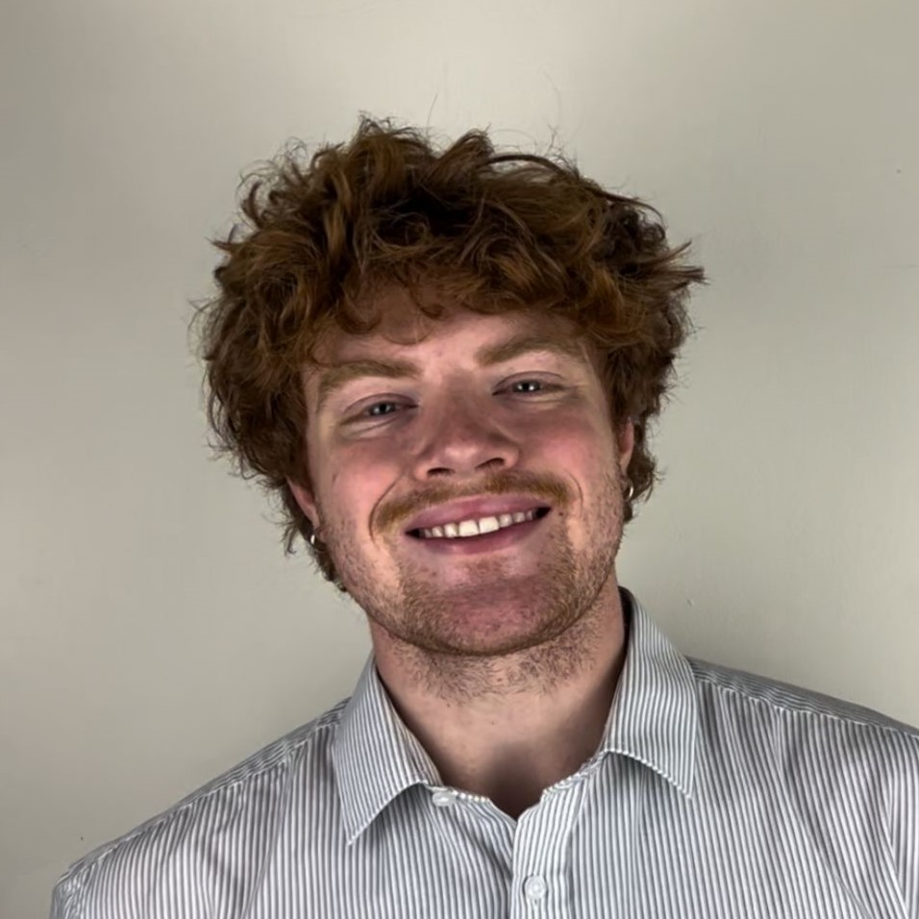
Who We Are?
CEO
Anthony
Creative director for future expansions
Experience in business consultancy
CTO
Reuben
Oversees app development
Catering and restaurant experience
COO
Seth
Organising restaurant partnerships
Sustainability engineer experience
CFO
Will
In charge of sales and investment
Experience in food delivery industry
Notes:
Our team consists of Anthony CEO, Reuben CTO, Seth COO, and myself, the CFO. Anthony has consulted businesses previously. Reuben has valuable experience working in the catering and restaurant industries. Seth is an ex-sustainability engineer, and I am a previous employee of large players in the food delivery industry.
Our cumulative knowledge covers all the main branches of the proposed venture and has provided crucial insider knowledge to maintain a steady project development.

Slide 20
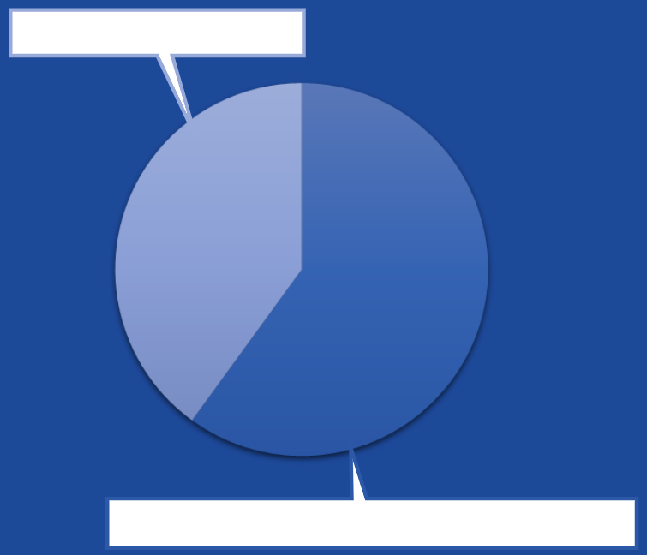
Investors & Funding
Small scale grants [5]:
Eat it up Hubbub food waste grant (up to £40k)
Small scale grants [5]:
Eat it up Hubbub food waste grant (up to £40k)
Potential Investors
Loans: Bristol city sustainable initiatives
£60,000 (applied) [6]
Loans: Bristol city sustainable initiatives
£60,000 (applied) [6]
£40,000
£60,000
We are looking for an investment of £40k in return for a 15% stake
We are looking for an investment of £40k in return for a 15% stake
Bristol City Sustainable Initiatives
Notes:
Climate focussed grants are setup frequently and these are an excellent opportunity for initial funding. Whilst frequent, many of these grants, such as the Hubbub “eat it up” fund, have recently closed.
Beyond grants, the Bristol City Council offers low interest investments for sustainable initiatives ranging from £50,000 - £1 million. We are in the process of applying for a £60,000 loan. Additionally, we are looking for a further £40,000 in exchange for a 15% stake in Still Tasty.
This money will be used to float the app development, advertising, and restaurant partnering.

Slide 21
Risks
Political
Regulatory compliance
Impact Shut down
Risk Catastrophic & Occasional
Mitigation Ensure proper refrigeration
New Risk Major & Very unlikely
Economic
Growth stagnation
Impact Not enough capital for future endeavours
Risk Moderate & Likely
Mitigation Conservative estimates for financials
New Risk Moderate & Unlikely
P
P
E
E
Social
Reputation Risk
Impact Less people use the app
Risk Moderate & Unlikely
Mitigation Spot checks to ensure food quality
New Risk Moderate & Rare
T
Technology
App breakdown
Impact Shut down
Risk Catastrophic & Likely
Mitigation Use an outside consultant
New Risk Catastrophic & Rare
S
T
S
Notes:
A PEST analysis was undertaken to understand the four biggest risks to the venture and how they should be mitigated.
The biggest political risk is food regulation compliance issues. While this should not happen very often it would be catastrophic as it could lead to StillTasty being forced to shut down. To mitigate this, proper refrigeration of food is vital. Furthermore, it is specified to the affiliates in the terms of service that they are liable for the standard of their food.
The largest economic risk would be growth stagnation as this would limit our ability to fund future endeavours and expansion into other geographical locations, this is quite likely as is the case for many startups. To mitigate this, we have built redundancy into our initial funding goal, and have conservative estimates for growth.
The main social risk is that we may lose reputation due to food quality decreasing and this being spread through word of mouth. To ensure this doesn’t happen, spot checks will be conducted to ensure food quality remains high.
The largest technology risk is the app breaking, this would lead to a total shut down in operations and so is a catastrophic risk. To prevent this, the team will pay an external consultant to assist with front and back end design for the StillTasty app.

Slide 22
References
[1]
https://cleanstreets.westminster.gov.uk/bar-cafe-club-and-restaurant-waste/
[2]
https://www.lightspeedhq.co.uk/blog/how-to-calculate-restaurant-food-costs-uk/
[3]
https://www.tripadvisor.co.uk/Restaurants-g186220-Bristol_England.html
[4]
https://democracy.bristol.gov.uk/documents/s45306/App%20A%20Population%20Bristol%20Nov%2019%20Extract.pdf
[5]
https://www.eatitupfund.org.uk
[6]
https://www.bristolonecity.com/climate/support-for-bristol-businesses/

Slide 23
Appendix Year 1 Finances
 | Year 1 |  |  |  |  |  |  |  |  |  |  |  | Year 1
 | M1 | M2 | M3 | M4 | M5 | M6 | M7 | M8 | M9 | M10 | M11 | M12 | Total
Sales / Income
Restaurants Involved | 0 | 20 | 40 | 43 | 46 | 50 | 54 | 59 | 64 | 70 | 76 | 83
Total number of sales | 0 | 0 | 0 | 1376 | 1472 | 1600 | 1728 | 1888 | 2048 | 2240 | 2432 | 2656 | 17440
Total sales (revenue) | 0 | 0 | 0 | 9632 | 10304 | 11200 | 12096 | 13216 | 14336 | 15680 | 17024 | 18592 | 122080
Direct Costs
Restaurant Commision | 0 | 0 | 0 | 5504 | 5888 | 6400 | 6912 | 7552 | 8192 | 8960 | 9728 | 10624 | 69760
Total cost of sales | 0 | 0 | 0 | 5504 | 5888 | 6400 | 6912 | 7552 | 8192 | 8960 | 9728 | 10624 | 69760
Gross profit | 0 | 0 | 0 | 4128 | 4416 | 4800 | 5184 | 5664 | 6144 | 6720 | 7296 | 7968 | 52320
Overheads / Indirect Costs
App/web development | 8000 | 8000 | 2000 | 0 | 0 | 0 | 0 | 0 | 0 | 0 | 0 | 0 | 18000
Advertising | 0 | 5000 | 10000 | 2000 | 2000 | 2000 | 2000 | 2000 | 2000 | 2000 | 2000 | 2000 | 33000
Partnering with restaurants | 4000 | 4000 | 4000 | 800 | 800 | 800 | 800 | 800 | 800 | 800 | 800 | 800 | 19200
App Maintenance | 0 | 0 | 0 | 400 | 400 | 400 | 400 | 400 | 400 | 400 | 400 | 400 | 3600
Legal Consultation | 1000 | 400 | 400 | 400 | 400 | 400 | 400 | 400 | 400 | 400 | 400 | 400 | 5400
Accountancy Fees | 60 | 60 | 60 | 60 | 60 | 60 | 60 | 60 | 60 | 60 | 60 | 60 | 720
-CRM | 0 | 0 | 0 | 400 | 400 | 400 | 400 | 400 | 400 | 400 | 400 | 400 | 3600
Total Overheads | 13060 | 17460 | 16460 | 4060 | 4060 | 4060 | 4060 | 4060 | 4060 | 4060 | 4060 | 4060 | 83520
Profit/Loss before tax | -13060 | -17460 | -16460 | 68 | 356 | 740 | 1124 | 1604 | 2084 | 2660 | 3236 | 3908 | -31200
Running Balance | -13060 | -30520 | -46980 | -46912 | -46556 | -45816 | -44692 | -43088 | -41004 | -38344 | -35108 | -31200

Slide 24
Appendix Year 2 Finances
Sales / Income
Restaurants Involved
Total number of sales
Total sales (revenue)
Direct Costs
Restaurant Commision
Total cost of sales
Gross profit
Overheads / Indirect Costs
App/web development
Advertising
Partnering with restaurants
App Maintenance
Legal Consultation
Accountancy Fees
-CRM
Total Overheads
Profit/Loss before tax
Running Balance
Year 2 |  |  |  |  |  |  |  |  |  |  |  | Year 2
M1 | M2 | M3 | M4 | M5 | M6 | M7 | M8 | M9 | M10 | M11 | M12 | Total
83 | 86 | 86 | 89 | 89 | 92 | 92 | 95 | 95 | 98 | 98 | 100
2656 | 2752 | 2752 | 2848 | 2848 | 2944 | 2944 | 3040 | 3040 | 3136 | 3136 | 3200 | 35296
18592 | 19264 | 19264 | 19936 | 19936 | 20608 | 20608 | 21280 | 21280 | 21952 | 21952 | 22400 | 247072
 |  |  |  |  |  |  |  |  |  |  |  | 0
 |  |  |  |  |  |  |  |  |  |  |  | 0
10624 | 11008 | 11008 | 11392 | 11392 | 11776 | 11776 | 12160 | 12160 | 12544 | 12544 | 12800 | 141184
10624 | 11008 | 11008 | 11392 | 11392 | 11776 | 11776 | 12160 | 12160 | 12544 | 12544 | 12800 | 141184
7968 | 8256 | 8256 | 8544 | 8544 | 8832 | 8832 | 9120 | 9120 | 9408 | 9408 | 9600 | 105888
 |  |  |  |  |  |  |  |  |  |  |  | 0
 |  |  |  |  |  |  |  |  |  |  |  | 0
0 | 0 | 0 | 0 | 0 | 0 | 0 | 0 | 0 | 0 | 0 | 0 | 0
2000 | 2000 | 2000 | 2000 | 2000 | 2000 | 2000 | 2000 | 2000 | 2000 | 2000 | 2000 | 24000
400 | 400 | 400 | 400 | 400 | 400 | 400 | 400 | 400 | 400 | 400 | 400 | 4800
400 | 400 | 400 | 400 | 400 | 400 | 400 | 400 | 400 | 400 | 400 | 400 | 4800
400 | 400 | 400 | 400 | 400 | 400 | 400 | 400 | 400 | 400 | 400 | 400 | 4800
60 | 60 | 60 | 60 | 60 | 60 | 60 | 60 | 60 | 60 | 60 | 60 | 720
400 | 400 | 400 | 400 | 400 | 400 | 400 | 400 | 400 | 400 | 400 | 400 | 4800
3660 | 3660 | 3660 | 3660 | 3660 | 3660 | 3660 | 3660 | 3660 | 3660 | 3660 | 3660 | 43920
 |  |  |  |  |  |  |  |  |  |  |  | 0
4308 | 4596 | 4596 | 4884 | 4884 | 5172 | 5172 | 5460 | 5460 | 5748 | 5748 | 5940 | 61968
 |  |  |  |  |  |  |  |  |  |  |  | 0
-26892 | -22296 | -17700 | -12816 | -7932 | -2760 | 2412 | 7872 | 13332 | 19080 | 24828 | 30768

Slide 25
Appendix Year 3 Finances
Sales / Income
Restaurants Involved
Total number of sales
Total sales (revenue)
Direct Costs
Restaurant Commision
Total cost of sales
Gross profit
Overheads / Indirect Costs
App/web development
Advertising
Partnering with restaurants
App Maintenance
Legal Consultation
Accountancy Fees
-CRM
Total Overheads
Profit/Loss before tax
Running Balance
Year 3 |  |  |  |  |  |  |  |  |  |  |  | Year 3
M1 | M2 | M3 | M4 | M5 | M6 | M7 | M8 | M9 | M10 | M11 | M12 | Total
100 | 103 | 103 | 106 | 106 | 110 | 110 | 113 | 113 | 115 | 115 | 118
3200 | 3296 | 3296 | 3392 | 3392 | 3520 | 3520 | 3616 | 3616 | 3680 | 3680 | 3776 | 41984
22400 | 23072 | 23072 | 23744 | 23744 | 24640 | 24640 | 25312 | 25312 | 25760 | 25760 | 26432 | 293888
12800 | 13184 | 13184 | 13568 | 13568 | 14080 | 14080 | 14464 | 14464 | 14720 | 14720 | 15104 | 167936
12800 | 13184 | 13184 | 13568 | 13568 | 14080 | 14080 | 14464 | 14464 | 14720 | 14720 | 15104 | 167936
9600 | 9888 | 9888 | 10176 | 10176 | 10560 | 10560 | 10848 | 10848 | 11040 | 11040 | 11328 | 125952
0 | 0 | 0 | 0 | 0 | 0 | 0 | 0 | 0 | 0 | 0 | 0 | 0
2000 | 2000 | 2000 | 2000 | 2000 | 2000 | 2000 | 2000 | 2000 | 2000 | 2000 | 2000 | 24000
400 | 400 | 400 | 400 | 400 | 400 | 400 | 400 | 400 | 400 | 400 | 400 | 4800
400 | 400 | 400 | 400 | 400 | 400 | 400 | 400 | 400 | 400 | 400 | 400 | 4800
400 | 400 | 400 | 400 | 400 | 400 | 400 | 400 | 400 | 400 | 400 | 400 | 4800
60 | 60 | 60 | 60 | 60 | 60 | 60 | 60 | 60 | 60 | 60 | 60 | 720
400 | 400 | 400 | 400 | 400 | 400 | 400 | 400 | 400 | 400 | 400 | 400 | 4800
3660 | 3660 | 3660 | 3660 | 3660 | 3660 | 3660 | 3660 | 3660 | 3660 | 3660 | 3660 | 43920
5940 | 6228 | 6228 | 6516 | 6516 | 6900 | 6900 | 7188 | 7188 | 7380 | 7380 | 7668 | 82032
36708 | 42936 | 49164 | 55680 | 62196 | 69096 | 75996 | 83184 | 90372 | 97752 | 105132 | 112800

Slide 26
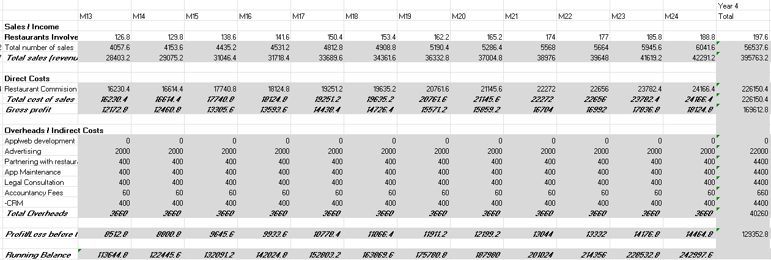
Appendix Year 4 Finances
This includes a compound scale that initiates after M12 in Year 3. This is an attempt to simulate the increase in scale after expansion.

Slide 27
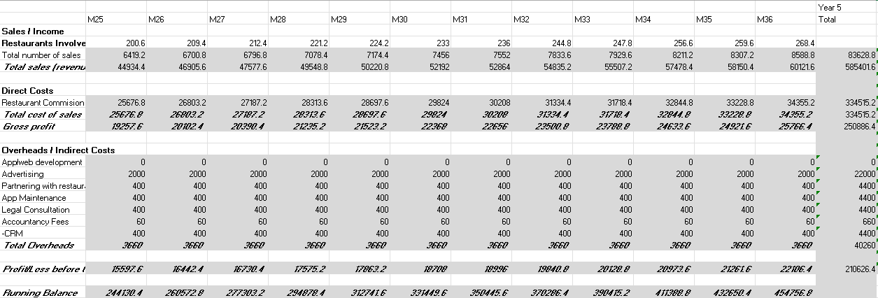
Appendix Year 5 Finances
The profit listed at the bottom right is the profit after year 5 and is multiplied by 2 to create a company value.

Slide 28
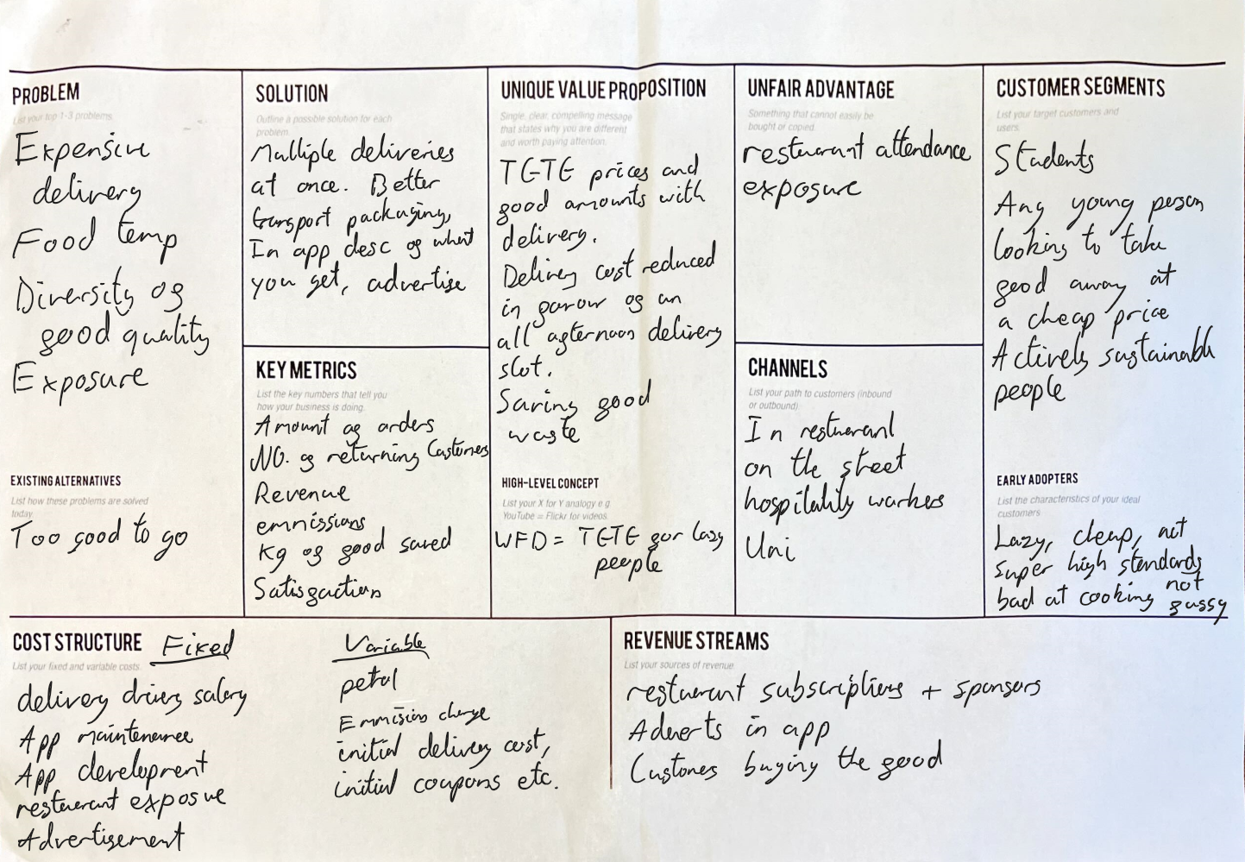
Appendix Value Analysis

Slide 29
Appendix Stakeholder Analysis
Stakeholder | Examples of the stakeholder | Importance of the project to them? (L/M/H) | How much influence do they have over the project? (L/M/H) | How could the stakeholder contribute to the project? | What is important to the stakeholder? | How could the stakeholder block the project | Strategy for engaging the stakeholder
End-user | Customers of Still Tasty | M | H | Providing answers to surveys to improve price figures or general parts of the app. Massive feedback opportunity. | The quality of the product, the availability of the product, the use of service we (the business) provide. | Reject the use of the app. Leave bad reviews of the app. | Keep seasonal with the app, include deals, keep things fresh and always updating. Create better appeal to the app. Advertise, competitive pricing.
Businesses | Cafe's, bakery's, restaurant's, take-away | H | H | Providing the product that the app will move. Contributing to having a wide array of food on the app. | Building profit with the app. Getting rid of food waste. | Reject use of the app. Not provide enough product for the app. | Providing advertising. Providing statistics. Regularly holding meetings to understand the need.
Government agency | Sustainability and food waste prevention | M | L | Providing funding based on waste statistics. Providing company incentive to focus on sustainability. Provide insight in how to be lawful as well as providing assistance to build the business. | The app meeting target sustainability goals. The app not breaking any law. | Not provide any funding. Block the project via tightening laws etc. | Funding a legal team to work through regulations. Ensure of the positive impacts the application could have on waste.
Employees | Front-end and back-end engineers, customer support, drivers | M | M | Providing functionality to the business. Customer support will be required for missed deliveries, drivers to do the deliveries, front end to update the websites themes and "keep up with the times", back end to update the app to keep it from bugs as well as add new restaurants and further develop the app. | Getting paid a sufficient amount. The work to be meaningful. Progress in their career. | Not coming to work. Providing inadequate service. | Providing work benefits, e.g. pension, discounts, insurances. Keeping regular contact, making them feel part of the company (HR).
Development team | Us | H | H | Developing the initial app, possibly providing initial funding. Solely driving the business initially. Pitch to investors, complete surveys, general market research. | Total entire success in all aspects of the business. | Not researching enough, not doing enough work in general, not preparing enough for initial launch. | Keep realistic goals, keep regular project health checks to make sure it is going in the right direction and will meet said goals.
Investor | Sustainability company, | L | M | Providing funding to grow the project. Provide consultancy to build the business. | Return on investment. Increased reputation in sustainability. | Not providing enough capital for initial development as well as ongoing if the project is taking a dip. | Carrying out meetings Provide concrete documentation Provide realistic promises and ensure a return on investment

Slide 30
Appendix Affiliate Survey

Slide 31

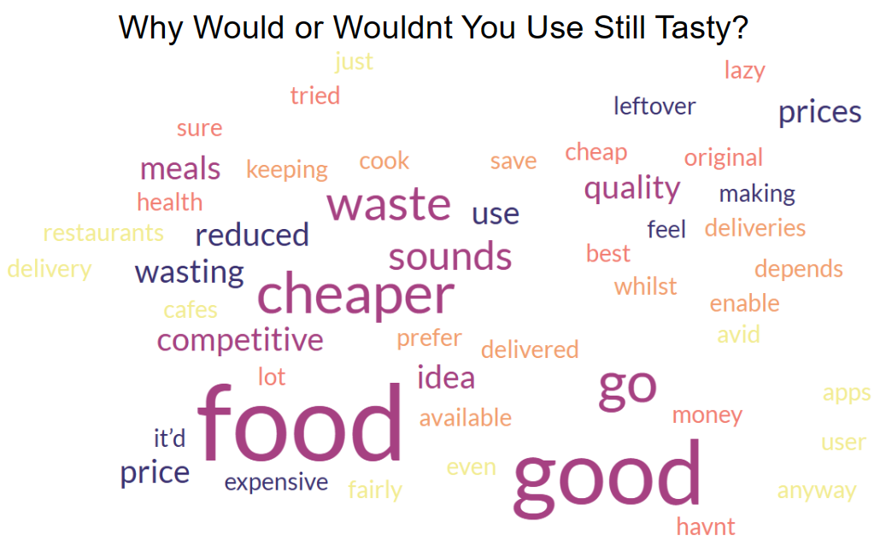
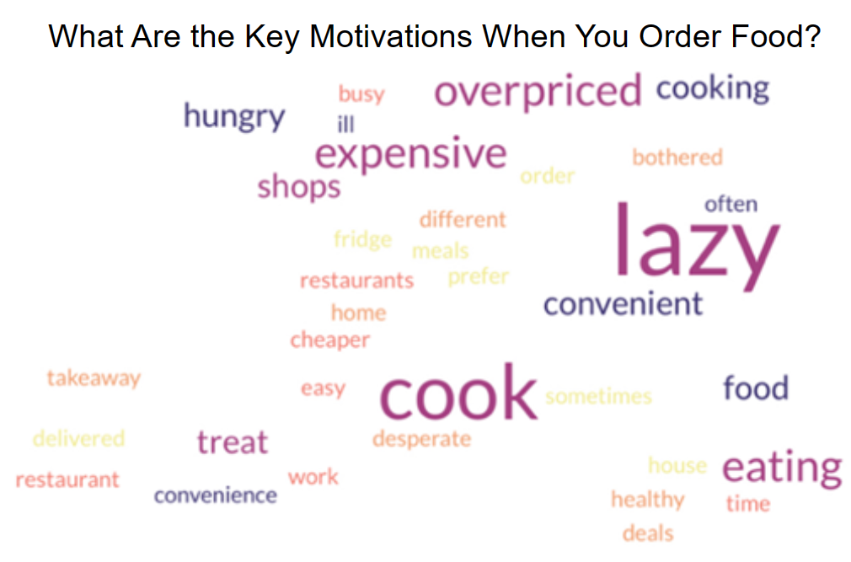
Appendix Customer Survey
60 Respondents ranging from “18-24” to “65+”
Never
Once or twice a year
Once or twice a month
Once or twice a week
More than once or twice a week

Slide 32
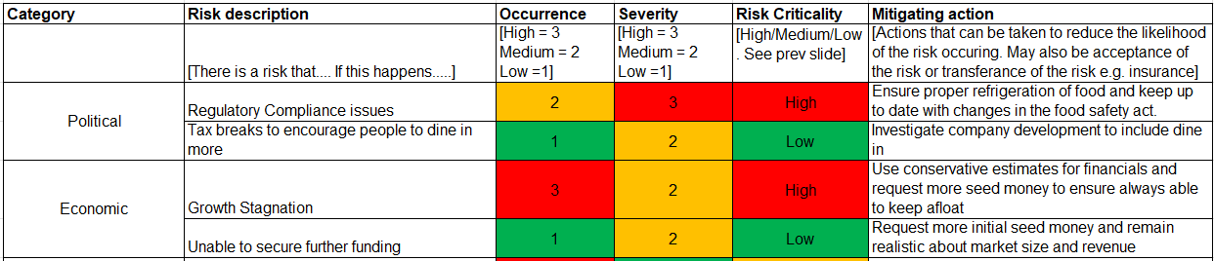
Appendix

Slide 33
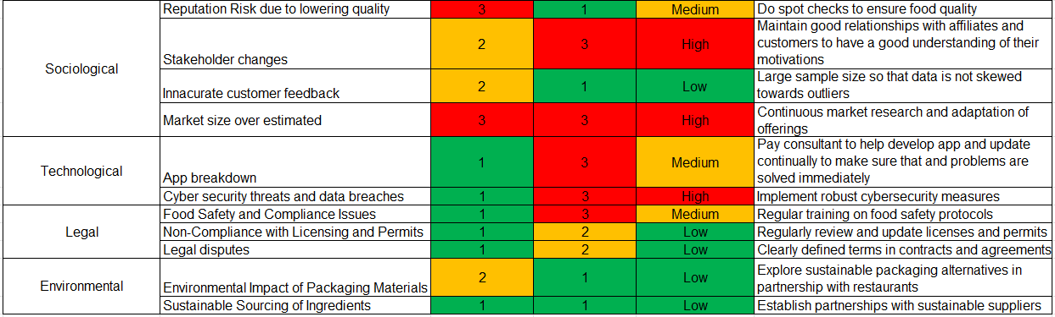
Appendix

